Slide 1
Prediction of Long-Distance Running Performance using Aerobic Training Indices
CDT Creighton Morgenfeld, Dr. Margaret Reynolds
MA389: United States Military Academy
April 10, 2023

Slide 2




Agenda
1
Background
2
Literature Review
3
Contributions to Field
4
Upcoming Work

Slide 3
Motivation
▶ Popularity of marathon and long-distance running

Slide 4
Motivation
▶ Popularity of marathon and long-distance running
▶ Well-established predictors of performance (VO₂ max, lactate threshold, etc.)

Slide 5
Motivation
▶ Popularity of marathon and long-distance running
▶ Well-established predictors of performance (VO₂ max, lactate threshold, etc.)
▶ Expensive, time consuming, and difficult tests

Slide 6
Motivation
▶ Popularity of marathon and long-distance running
▶ Well-established predictors of performance (VO₂ max, lactate threshold, etc.)
▶ Expensive, time consuming, and difficult tests
▶ Training indices bridge gap (distance, pace, training sessions, etc.)

Slide 7
Motivation

Slide 8
Statistical Models
Draw conclusions from real world data to create a specific model

Slide 9
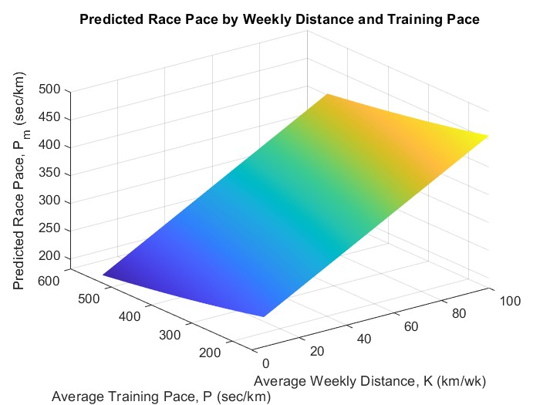
Tanda’s Model
P_{m} = 17.1 + 140e^{−0.0053K} + 0.55P

Slide 10
Mechanistic Models
Rely on “mechanics” of a phenomenon to craft a general model

Slide 11
Keller’s Problem
Given the following:
dv 1
_{dt} + _{τ} v = f (t ),
= σ − f (t )v (t ),
T , τ, σ
f (t ) ≤ F
dE dt
E (0) = E₀
Maximize:
T
D = v (t ) dt
0

Slide 12
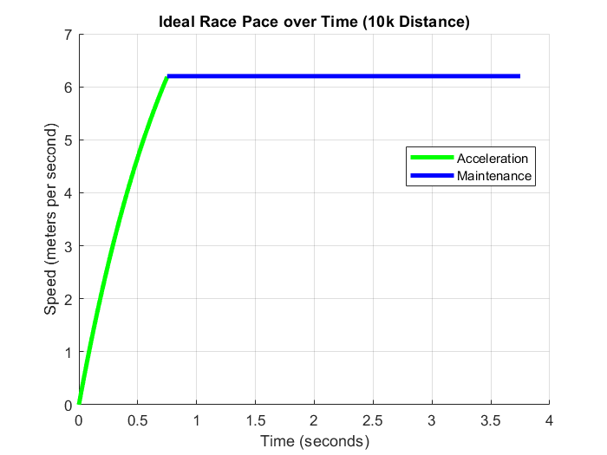
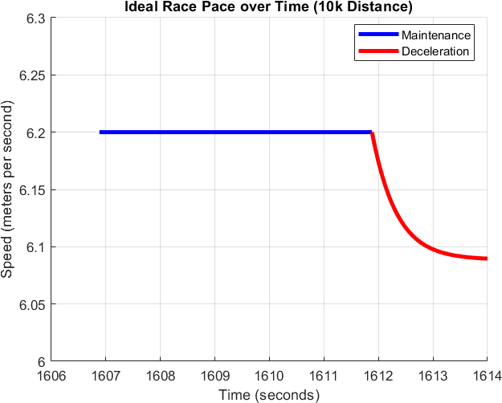
Keller’s Model

−t/τ
F τ (1 − e ),
0 ≤ t ≤ t₁

v (t ) =
τ/λ, t₁ ≤ t ≤ t₂
^{J}στ + [v ²(t₂) − στ ]e^{−2(t2−t )/τ} , t₂ ≤ t ≤ T

Slide 13
Links between Models
A hybrid approach lends both a groundedness and generalizability, while also
informing estimates and linking past performance to future predictions

Slide 14
Links between Models

Slide 15
Basis of Work
▶ Grounded in Keller’s work [1, 2]
▶ Minimize tests, use training indices
▶ Sub-maximal VO₂ estimate [3]
▶ 3 sprints (50m, 100m, 150m)

Slide 16
Contributions
Easy
Effective Applicable

Slide 17

Contributions
▶ Ease of understanding
▶ Effective communication
▶ Applicable to the world
Placeholder QR –> will link to webpage w/tool

Slide 18
Way Ahead
▶ Strengthen links between approaches
▶ Utilize variations of base model [4]
▶ Refine communication
Placeholder QR –> will link to webpage w/tool

Slide 19
References
Joseph B. Keller, A theory of competitive running, Physics Today 26 (1973), 43–47.
, Optimal velocity in a race, The American Mathematical Monthly 81 (1974), no. 5, 474–480.
W D. Taylor, J D. George, P E. Allsen, P R. Vehrs, R L. Hager, and M P. Roberts, Estimation of VO2 max from a 1.5-Mile Endurance Test 35 (2003), no. 5.
William Woodside, The optimal strategy for running a race (a mathematical model for world records from 50 m to 275 km), Mathematical and Computer Modelling 15 (1991), no. 10, 1–12.

